Slide 1
Section 8
Built-Decorators in Python
Sep 2022 SDCloud3
1

Slide 2
@staticmethod
Methods associated with the class rather
than an object
Sep 2022 SDCloud3

Slide 3
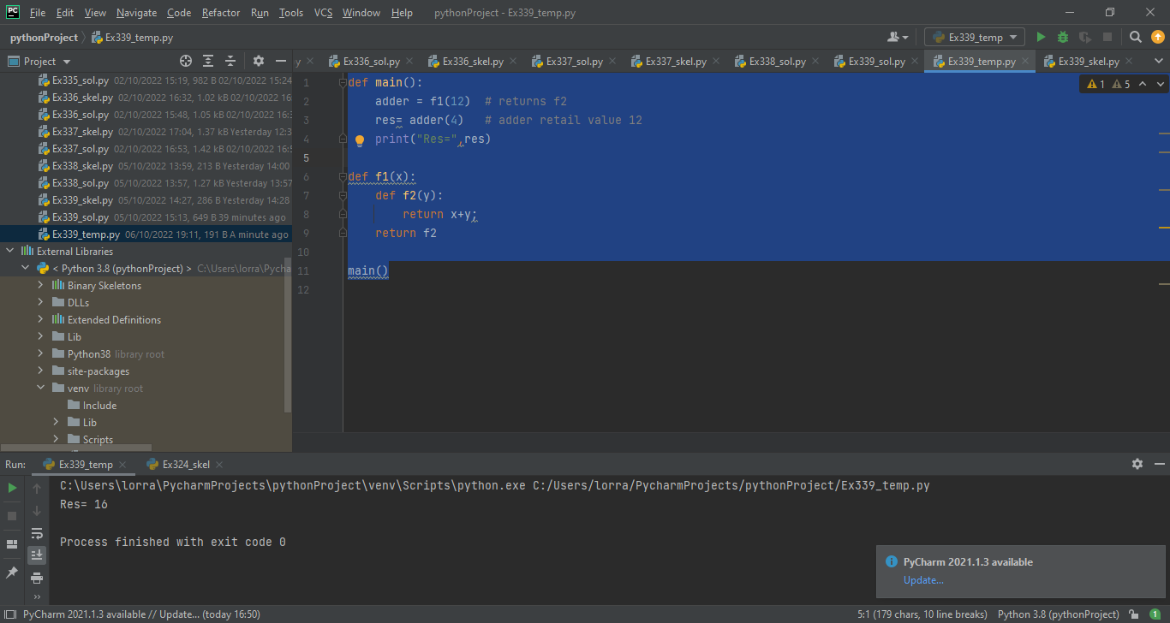
Regular Class
- no static methods
class Stepper():
def __init__(self, value):
self.__value =value
def stepUP(self):
self.__value += 1
def stepDown(self):
self.__value -= 1
def readValue(self):
return self.__value
s1= Stepper(6)
2006
2008
2010
2012
2010
2010
6
self
s1
value
Sep 2022 SDCloud3

Slide 4
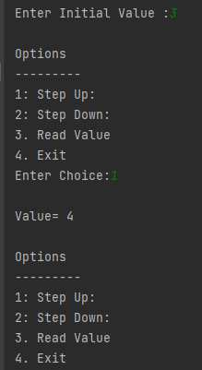
Regular Class
- no static methods
def main():
value = int(input('Enter Initial Value :'))
s1= Stepper(value)
choice=3
while(choice != 4):
print('\nOptions')
print('---------')
print('1: Step Up: ')
print('2: Step Down: ')
print('3. Read Value')
print('4. Exit')
choice = int(input('Enter Choice:'))
if (choice== 1):
s1.stepUP()
print("\nValue=", s1.readValue())
elif (choice== 2):
s1.stepDown()
:
Sep 2022 SDCloud3

Slide 5

Static Methods & Variables:
Not associated with an object
class Stepper():
__count =0
def __init__(self, value):
self.__value =value
Stepper.__count +=1
@staticmethod
def readCount( ):
return Stepper.__count
def stepUP(self):
self.__value += 1
s1= Stepper(6)
s2= Stepper(4)
s3= Stepper(7)
2006
2008
2010
2012
2014
2010
2010
2012
2014
3
6
4
7
self
s1
s2
s3
count
value
value
value
Sep 2022 SDCloud3

Slide 6
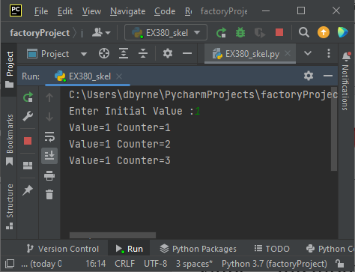
Static Methods
def main():
value = int(input('Enter Initial Value :'))
s1= Stepper(value)
print("Value={0} Counter={1}".format(s1.readValue(),
Stepper.readCount()))
s2= Stepper(value)
print("Value={0} Counter={1}".format(s2.readValue(),
Stepper.readCount()))
s3= Stepper(value)
print('Value={0} Counter={1}'.format(s3.readValue(),
Stepper.readCount()))
Sep 2022 SDCloud3

Slide 7
Static Methods
(Example2)
def main():
value = int(input('Enter Initial Value :'))
s1= Stepper(value)
print("Value={0} Counter={1}".format(s1.readValue(),
s1.readCount()))
s2= Stepper(value)
print("Value={0} Counter={1}".format(s2.readValue(),
s2.readCount()))
s3= Stepper(value)
print('Value={0} Counter={1}'.format(s3.readValue(),
s3.readCount()))
Sep 2022 SDCloud3

Slide 8
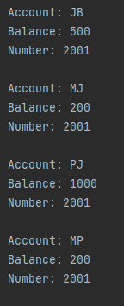
Ex381
class Account():
def __init__(self, name,balance):
self.__name=name
self.__balance=balance
self.__accounts = 0 #This must be static
self.__accounts +=1
self.__number= 2000 + self.__accounts
def deposit(self, amt):
self.balance += amt
def withdraw(self, amt):
self.balance -= amt
def printDetails(self):
print('\nAccount: {0}'.format(self.__name))
print('Balance: {0}'.format(self.__balance))
def readNumber(self):
return self.__number
Sep 2022 SDCloud3

Slide 9
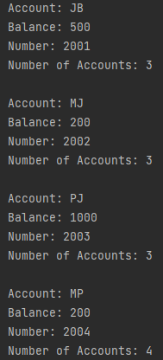
Ex381
__accounts var = # accounts Created
To achieve results shown.
Make __accounts a class variable
Modify constructor __init__ to access __accounts
Introduce static method
Account.readNumberOfAccounts()
4. Remove comments in main()
Sep 2022 SDCloud3

Slide 10
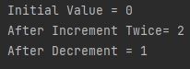
class Unary():
@staticmethod
def increment(x):
return x+1
@staticmethod
def decrement(x):
return x - 1
def main():
value=0
print('Initial Value = {0}'.format(value))
value = Unary.increment(value)
value = Unary.increment(value)
print('After Increment Twice= {0}‘
.format(value))
value=Unary.decrement(value)
print('After Decrement = {0}'
.format(value))
Static methods only
Sep 2022 SDCloud3

Slide 11
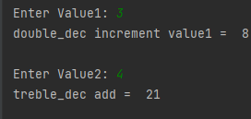
Recall
Decorators That
Take Arguments
def treble_decorator(func):
def closure(*args):
res=func(*args)
return res*3
return closure
@double_decorator
def increment(x):
return x + 1
@treble_decorator
def add(x,y):
return x+y
Ex382
Sep 2022 SDCloud3

Slide 12
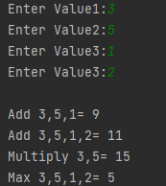
Ex 382
Complete class Calculate
With static methods
Taking variable # args
def main():
value1 = int(input('Enter Value1:'))
value2 = int(input('Enter Value2:'))
value3 = int(input('Enter Value3:'))
value4 = int(input('Enter Value3:'))
print('\nAdd {0},{1},{2}= {3}'.
format(value1,value2,value3, Calculate.add(value1,value2,value3)))
print('Add {0},{1},{2},{3}= {4}'.format(value1,value2,value3, value4,
Calculate.add(value1,value2,value3,value4)))
print('Multiply {0},{1}= {2}'.format(value1,value2,
Calculate.product(value1,value2)))
print('Max {0},{1},{2},{3}= {4}'.format(value1,value2,value3, value4,
Calculate.maximum(value1,value2,value3,value4)))
Sep 2022 SDCloud3

Slide 13
@classmethod
Like @staticmethod except Includes class as a parameter
Typically used in style of static factory pattern
s2=Student.createNewStudent('Tony Kennedy')
s2.printDetails()
Sep 2022 SDCloud3

Slide 14
@classmethod Like Static except Includes class as a parameter
Typically used in style of static factory pattern
class Student:
def __init__(self, first,second):
self.__first =first
self.__surname = second
@classmethod
def createNewStudent(cls, fullName):
list=fullName.split(' ')
return cls(list[0],list[1])
s2=Student.createNewStudent('Tony Kennedy')
s2.printDetails()
Sep 2022 SDCloud3

Slide 15
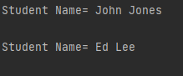
class Student:
def __init__(self, first,second):
self.__first =first
self.__surname = second
@classmethod
def createNewStudent(cls, fullName):
list=fullName.split(' ')
return cls(list[0],list[1])
def changeSurname(self, second):
self.__surname = second
def printDetails(self):
print('\nStudent Name= {0} {1}'.
format(self.__first,self.__surname))
def main():
s1=Student('John', 'Smith')
s1.changeSurname('Jones')
s1.printDetails()
s2=Student.createNewStudent('Ed Lee')
s2.printDetails()
Sep 2022 SDCloud3

Slide 16
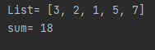
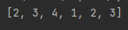
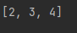
class DataList:
def __init__(self, list):
self.__list = list
def addData(self):
result=0
for el in self.__list:
result += el
return result
def printData(self):
print('\nList= {0}'.format(self.__list))
Ex383
def main():
list=[3,2,1,5,7]
d1=DataList(list)
d1.printData()
print('sum=',d1.addData())
def f(*args):
print(list(args))
def main():
f(2,3,4)
def main():
myList = list(map(int, str(234123)))
print(myList)
Sep 2022 SDCloud3

Slide 17
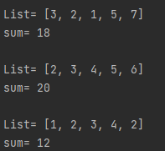
class DataList:
def __init__(self, list):
self.__list = list
def addData(self):
result=0
for el in self.__list:
result += el
return result
# Add Class Methods here
def printData(self):
print('\nList= {0}'.format(self.__list))
def main():
list1=[3,2,1,5,7]
d1=DataList(list1)
d1.printData()
print('sum=',d1.addData())
d2= DataList.createDataArgs(2,3,4,5,6)
d2.printData()
print('sum=',d2.addData())
d3= DataList.createDataNumber(12342)
d3.printData()
print('sum=',d3.addData())
Ex383 complete
class Methods
Sep 2022 SDCloud3

Slide 18
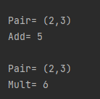
Class v Static Methods
class Pair:
__x = 0
__y = 0
def __init__(self, value1,value2):
Pair.__x = value1
Pair.__y = value2
@classmethod
def add(cls):
Pair.printData()
return cls.__x + cls.__y
@staticmethod
def mult(optionalPar):
optionalPar.printData()
return optionalPar.__x *
optionalPar.__y
@classmethod
def printData(cls):
print('\nPair= ({0},{1})'.
format(cls.__x,cls.__y))
def main():
p=Pair(2,3)
print("Add=",p.add())
print("Mult=",p.mult(Pair))
#Could also be called
p=Pair(2,3)
print("Add=",Pair.add())
print("Mult=",Pair.mult(Pair))
Sep 2022 SDCloud3

Slide 19
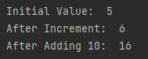
@property
Access private data as if public
def main():
c=Counter(5)
print('Initial Value: ', c.Value)
c.increment()
print('After Increment: ', c.Value)
c.Value = c.Value+10
print('After Adding 10: ', c.Value)
class Counter:
def __init__(self, value1):
self.__value = value1
def increment(self):
self.__value+= 1
Replaces getter/setter methods
Sep 2022 SDCloud3

Slide 20
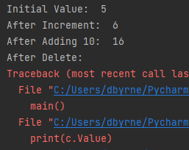
class Counter:
# constructor etc goes here
@property
def Value(self):
return self.__value
@Value.setter
def Value(self,new_Value):
self.__value=new_Value
@Value.getter
def Value(self):
return self.__value
@Value.deleter
def Value(self):
del self.__value
def main():
c=Counter(5)
print('Initial Value: ', c.Value)
c.increment()
print('After Increment: ', c.Value)
c.Value = c.Value+10
print('After Adding 10: ', c.Value)
del c.Value
print('After Delete: ')
print(c.Value)
Sep 2022 SDCloud3

Slide 21
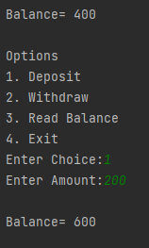
Ex384
class Account:
def __init__(self,number,balance):
self.__number = number
self.__balance = balance
def deposit(self,amt):
self.__balance+= amt
def main():
a=Account('B234234', 200)
choice=0
while (choice!=4):
print('\nOptions')
print('1. Deposit')
print('2. Withdraw')
print('3. Read Balance')
print('4. Exit')
choice=int(input('Enter Choice:'))
if (choice==1):
amt=int(input('Enter Amount:'))
a.deposit(amt)
print('\nBalance=',a.Balance)
Sep 2022 SDCloud3

Slide 22
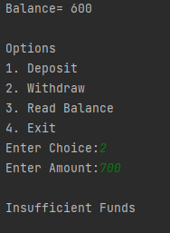
Ex384
class Account:
def __init__(self,number,balance):
self.__number = number
self.__balance = balance
# Add @property Balance
(getter & Setter)
if (choice==1):
amt=int(input('Enter Amount:'))
a.deposit(amt)
print('\nBalance=',a.Balance)
elif (choice==2):
amt=int(input('Enter Amount:'))
if (amt>a.Balance):
print('\nInsufficient Funds')
else:
a.Balance = a.Balance- amt
print('\nBalance=',a.Balance)
else:
print('\nBalance=',a.Balance)
Sep 2022 SDCloud3

Slide 23
@abstractmethod
from abc import ABC, abstractmethod
class AbstractClassExample(ABC):
def __init__(self, value):
self.value = value
super().__init__()
@abstractmethod
def do_something(self):
pass
class DoAdd42(AbstractClassExample):
def do_something(self):
return self.value + 42
d = DoAdd42()
May 2004 MSc Slide

Slide 24
class MyList(ABC): from abc import ABC, abstractmethod
def __init__(self,a, b):
self._first = a
self._second = b
@abstractmethod
def add(self):
return self._first + self._second
@abstractmethod
def print(self):
pass
class Pair(MyList):
def __init__(self, a, b):
MyList.__init__(self, a,b)
def add(self):
return self._first + self._second
def print(self):
print('Pair ({0},{1})'.format(self._first, self._second))
class Treble(MyList):
def __init__(self, a, b, c):
MyList.__init__(self, a,b)
self._third = c
def add(self):
return self._first + self._second + self._third
def print(self):
print('Treble ({0},{1},{2})'.format(self._first, self._second, self._third))
class Quad(MyList):
def __init__(self, a, b, c, d):
MyList.__init__(self, a,b)
self._third = c
self._fourth = d
def add(self):
return self._first + self._second + self._third + self._fourth
def print(self):
print('Quad ({0},{1},{2},{3})'.format(self._first, self._second, self._third, self._fourth))
def main():
pair1= Pair(2,3)
quad1= Quad(3,4,5,6)
treble1=Treble(3,4,5)
pair2= Pair(6,4)
list=[pair1, quad1, treble1, pair2]
print('List of Objects')
print('===============')
for el in list:
el.print()
print('Sum=', el.add())
print()
main()
Ex385
May 2004 MSc Slide

Slide 25
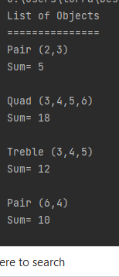
class Treble(MyList):
class Quad(MyList):
def main():
pair1= Pair(2,3)
quad1= Quad(3,4,5,6)
treble1=Treble(3,4,5)
pair2= Pair(6,4)
list=[pair1, quad1, treble1, pair2]
print('List of Objects')
print('===============')
for el in list:
el.print()
print('Sum=', el.add())
print()
main()
Ex385
May 2004 MSc Slide

